Slide 1

Meet the Funders
November 18, 2022
Community Room, C. Burr Artz Library

Slide 2
Funding Areas of Interest
Funding Areas | Ausherman Family Foundation | Delaplaine Foundation, Inc. | Frederick County Government Community Partnership Grant Program | Helen J Serini Foundation | Kahlert Foundation | The Community Foundation of Frederick County | United Way of Frederick County
Health |  |  |  |  |  |  | 
Human Services |  |  |  |  |  | 
Substance Use Disorder |  |  |  |  |  |  | 
Arts & Culture |  |  |  |  |  | 
Public/Society Benefit | 
Children, Youth, and Families |  |  |  |  |  |  | 
Food Security |  |  |  |  |  | 
Poverty Alleviation ‐ root causes, systems change, economic development |  |  |  |  |  |  | 
Economic Opportunity/ Financial Stability |  |  |  |  |  |  | 
Community Development/ Community Needs |  |  |  |  | 
Education |  |  |  |  |  |  | 
Historic Preservation |  |  |  |  |  | 
Spiritual Enlightenment |  | 
Agriculture |  |  |  |  |  | 
Environment |  |  |  |  |  | 
Technical Training |  |  |  |  |  | 
Animal Welfare |  |  |  |  |  | 
Civic Interests |  |  |  |  |  | 
Homelessness/Housing |  |  |  |  |  |  | 
Elder Care/ Senior Needs |  |  |  |  |  |  | 
Advocacy |  |  |  |  |  |  | 
1

Slide 3

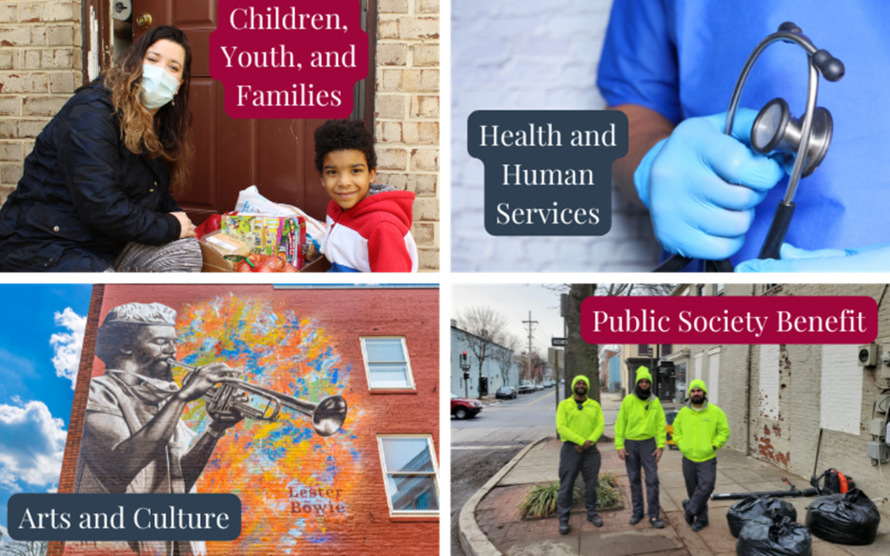
Executive Director, Leigh Adams ladams@ausherman.org
Grants Manager, Lori Perkins lperkins@ausherman.org
Admin. Asst., Caylee Winpigler cwinpigler@ausherman.org
Community Impact Mgr., Kat Vicere kvicere@ausherman.org
Our Grants
General Grants | open continuously
Capacity Building Grants | 2 cycles/year Dec 1-Jan 15 & Jun 1-Jul 15
Multi-Year Grants | Generally, by invitation only
IDEA Grants | Grants for grassroots, Black-led organizations (Spring & Fall Cycles)
Community Benefit Projects | May be initiated internally or by a local organization
https://www.aushermanfamilyfoundation.org

Slide 4

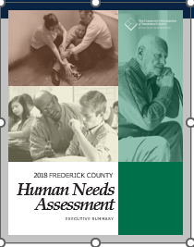
Who to contact with questions:
Mark Kamie, Community Impact Manager
m.kamie@frederickcountygives.org
301-695-7660
Diana Fulchiron, Director of Community Impact
d.fulchiron@frederickcountygives.org
Our grant funding is divided into three broad areas with different applications and deadline.
Important dates:
Women’s Giving Circle Grants Feb 15-Mar 15
Strategic Grants Jul 15-Aug 15
Impact Grants Aug 15-Sep 15
2018 Human Needs Assessment with 2022 Update
2018
Supporting families with children
Preparing for an aging population
Responding to substance use disorder
2022
Supporting access to affordable housing
Addressing mental health needs
Alleviating disparities in service delivery
https://www.frederickcountygives.org/Grants Apply Here

Slide 5
City of Frederick’s Community Promotion Grant Funding Cycle
Who to contact?
Assistant to the Mayor: Gayon Sampson gsampson@cityoffrederickmd.gov
Community Engagement Specialist: Lauren Paulet lpaulet@cityoffrederickmd.gov
Application Process
To submit an application, interested organizations should do the following:
Review the Program Overview
Ensure all reporting is up to date (if previous funding has been granted)
All applicants MUST attend one of the two information sessions on the following dates:
  December 1, 2022 | 10-11AM ET | City Hall Boardroom | RSVP Here
  January 10, 2023 | 1-2PM ET | City Hall Boardroom | RSVP Here
Complete the Online Application
Please let City staff know if you have any questions.
The City of Frederick's Community Promotion Grant Funding Cycle is now open for FY2024. The program awards up to $20,000 to supplement existing funds that either create or enhance services to positively impact city residents. Any 501 (c)(3), (c)(4), or (c)(6) organization with programs in the City of Frederick is eligible to apply.

Slide 6

Community Partnership Grant Program
CPG is an open and competitive grant program for nonprofit organizations that provide human service resources to Frederick County citizens.
Funding Priorities
Program Budgets by Fiscal Year
FY16/17
$750K
FY19, 20 & 21
$850K
FY22 & 23
$1,000,000
FY18
$825K
Housing
Seniors
Community Needs
The FY24 CPG budget will be determined in the CE’s proposed budget.
FY24 Cycle Timeline
Grant Types Awarded
Application Opens | November 21, 2022
Application Closes | December 16, 2022 @ 4:00 p.m.
Evaluation Period | January/February 2023
Proposed Awardees Announced | April, 2023 (when CE releases proposed budget)
Final Recipient Notification | May, 2023 (after budget is adopted)
Funding Period | July 1, 2023 to June 30, 2024
One Time
Operating
Information and contact info:
www.FrederickCountyMD.gov/CPG
Rich History, Bright Future

Slide 7

WHAT WE FUND:
Nonprofit organizations whose missions are related to the cultural arts, educational advancement, health, human services, historical preservation, and spiritual enlightenment.
WHAT WE DO NOT FUND:
Individual scholarships, organizations without an EIN number, government agencies, and for-profit businesses.
WHO IS ELIGIBLE:
Organizations recognized by the IRS as a tax-exempt public charity under Section 501(c)3 and 509(a) of the Internal Revenue Code.
DEADLINE FOR APPLYING:
Our yearly grant cycle ends and begins each year on October 1^{st.}
Approximately 70% – 75% or more of our grant funding is awarded annually in Frederick County.
https://delaplainefoundation.org/apply-for-funding/

Slide 8


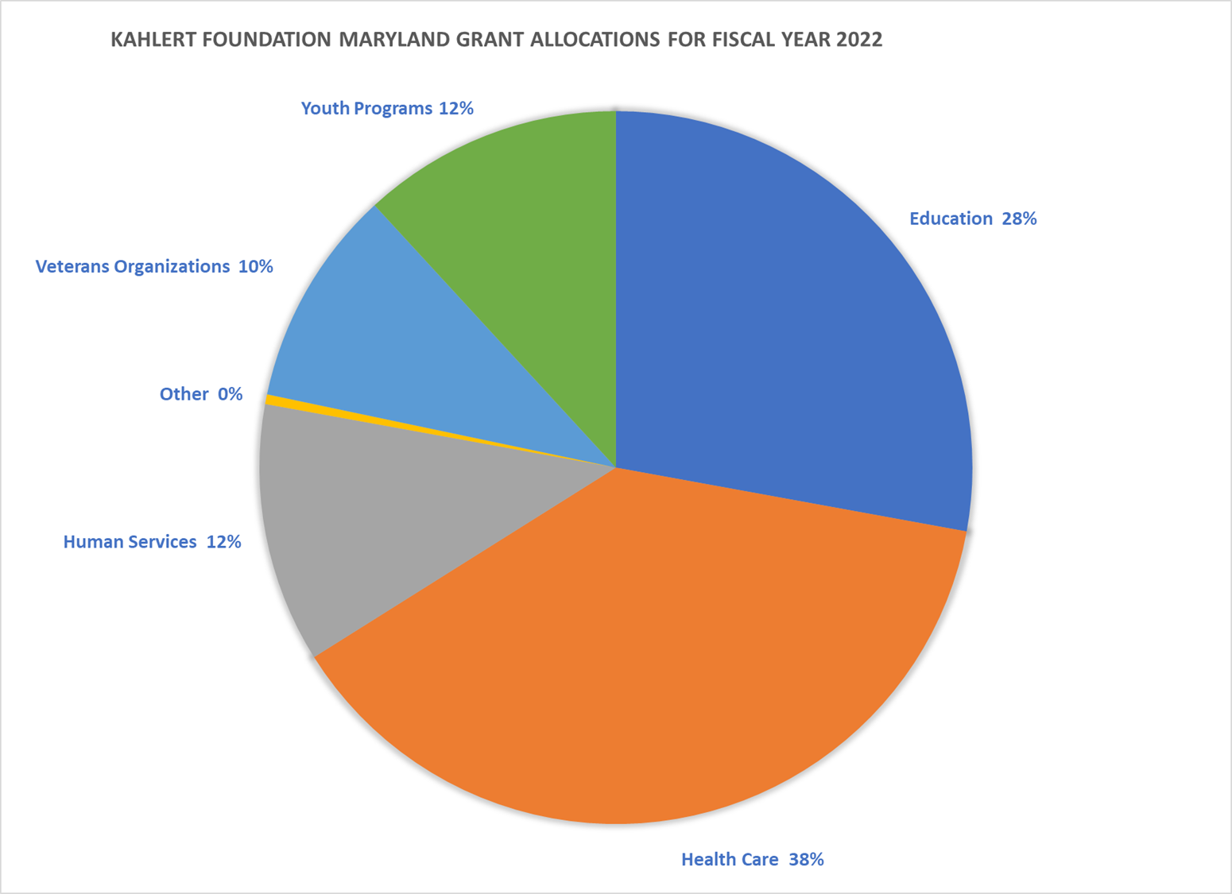
Areas of Focus
Health Care
Youth Programming
Education
Veterans
Human Services
Where we fund in Maryland
Baltimore City
Baltimore County
Carroll County
Frederick County
Howard County
Grant Deadline Request | Board Meeting
January 1 | February
May 1 | June
September 1 | October
The Kahlert Foundation

Slide 9

Grant Guidelines
Grant requests must follow the guidelines listed below:
​
Grants are for organizations serving the states of Maryland and surrounding areas. In Maryland, the primary focus is in the geographic areas listed below:
  Baltimore City
  Baltimore County
  Carroll County
  Frederick County
  Howard County
The Kahlert Foundation makes grants in the areas of health care, education, youth programs, veteran organizations, and human services.
Organizations must submit their 501(c)(3) document under the Internal Revenue Code.
Organizations must be rated by Guidestar with a strong preference for organizations with at least a Silver Seal of Transparency. The Kahlert Foundation will look most favorably on those organizations with a Platinum Seal of Transparency. The Foundation is committed to supporting organizations that spend a high percentage of their funds on programs and service, not administration and fund raising.

Slide 10
Grant requests must be for programs that improve the quality of life for the community and individuals with measurable results.
Grants may be awarded for capital campaigns, special projects or programs, staffing, and general operations.
Grant requests must show a need for the request, its impact, and effectiveness.
Organizations need to demonstrate good leadership, financial stability, and a minimum history of 2 years of existence.
Grants may be for one year or multi-year.
New grantees are required to complete a Letter of Intent prior to being considered for a grant. The review process for new grantees may take 60 days or more.
While the foundation may make grants for several years to an organization there are no guarantees of funding in perpetuity.

Slide 11

We envision thriving communities where all people live healthy, dignified lives regardless of means or identity. The Helen J. Serini Foundation supports innovative interventions that remove or address the root causes of systemic barriers to health, safety, shelter and opportunity in the communities where we work and live.
Geographic Area of Scope: Frederick County, Baltimore County, Baltimore City, Anne Arundel County, and some statewide work at the advocacy, policy, and research level.
Funding Focus: Systems-level navigation and systems change work, specifically as it relates to issues that contribute to cyclical and generational poverty and economic inequities.
Grant Programs:
Major Grants: $5000+, unrestricted grants (no project or program-specific funding options) open call for Letters of Intent in one grant cycle/year, usually due in early Spring
Leadership Development Grants: up to $5000 per organization, specifically to support professional development for nonprofit staff/volunteers, rolling basis
because our grant programs and timelines shift slightly each year, the most up-to-date information on deadlines, priorities, and opportunities will always be on our website at www.hjsfoundation.org
Contact: Kerry McHugh, VP, Program Officer: kmchugh@hjsfoundation.org*
*note that because of our small staff size (just two part-time staff!) we may take a bit to respond, and the weeks leading up to LOI submission deadlines tend to fill up incredibly quickly

Slide 12





Nonprofit Resources Links
Ctrl+Click to access links
(for software, hardware, and services)
(Read & Write Reviews of Foundations. Help Colleagues. Get Grants.)
(Grant Seekers Resource Center)
GuideStar + Foundation Center = Candid
Grant Seeker Resource Center/Foundation Directory
Seals of Transparency

Slide 13

Upcoming Events
Funders Data Report to the Nonprofit Community
December 7 @ 10A via Zoom
2023 Nonprofit Summit
TBD In April
Lattes with Lori @ Dublin Roaster
  3 times/year 2023 dates TBD

Slide 14

Q & A
Thank You for Attending!

